Slide 1
www.eiassociates.com
EI Contact: Brian Donnelly 973-775-7777 ext. 127

Slide 2
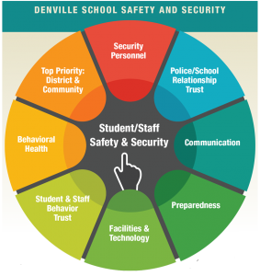
Michael Wozny
VP - Educational Projects
EI Associates
Jerry Marinelli
Director of Facilities & Security Denville Schools
Former Police Chief
Dr. Steven Forte
Superintendent Denville Schools

Slide 3
Background and why is this so important?

Slide 4
Myths & Obstacles “It can’t happen here” “If you can’t do everything don’t do anything”
Quotes
“Take 10 seconds each day to think about what you would do if…”

Slide 5
Top Priority- district and community
Number one priority for all is to provide safe places to learn.
Consider schools not like a prison more like a castle… beautiful but secure

Slide 6
Police School- Relationship and Trust
Identify personnel who will collaborate effectively
“Remember it may not be you and that is OK”

Slide 7
Communication
Communicate to all stakeholders
Communicate Collaboratively- letters and presentations as a team, police and schools
Reassure public that safety and security is Priority #1

Slide 8
Student and Staff Behavior and Trust
Lock doors
No propping doors open
Buy-in from staff and students
Students and staff sharing information
Visitors- “State your name and purpose for your visit” everytime.

Slide 9
Facilities and Technology
Lock doors
Harden target
Communication Systems
Cameras
Vestibules

Slide 10
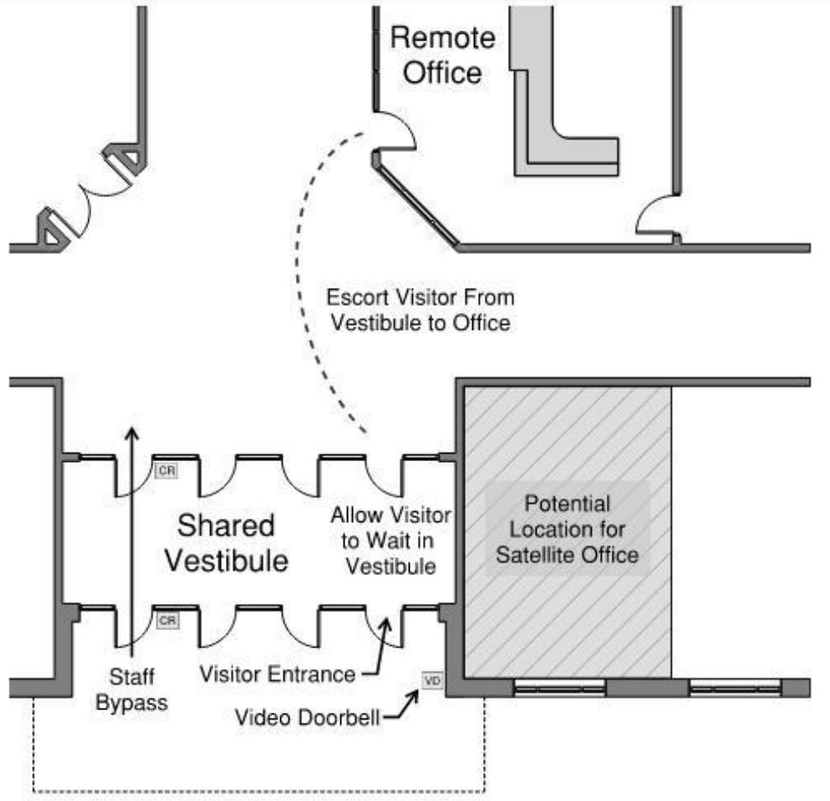
Facilities and Technology
Remote Office:
Office Not Adjacent to Vestibule
Indirect Communication
Vestibule Shared By Authorized Users and Unprocessed Visitors

Slide 11
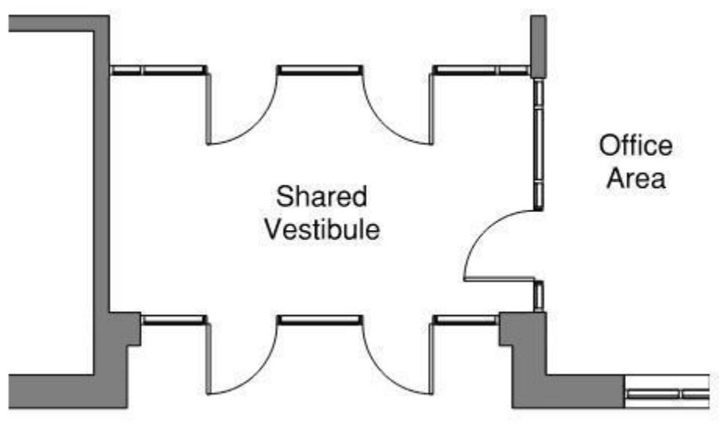
Facilities and Technology
Semi-Secure Vestibule:
Office Adjacent to Vestibule with Direct Contact
Vestibule Shared By Authorized Users and Unprocessed Visitors

Slide 12
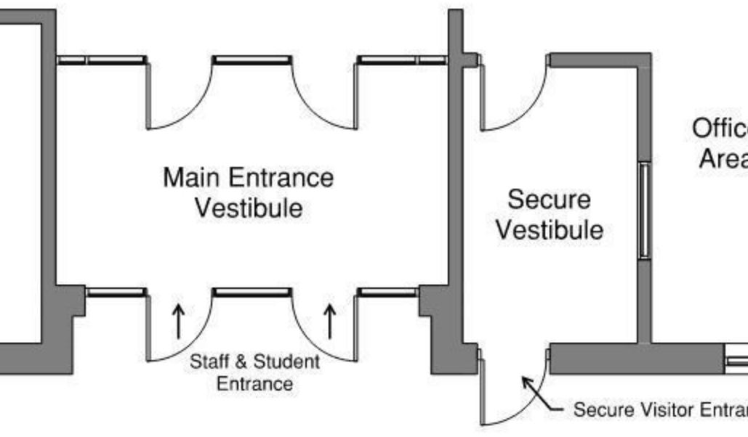
Facilities and Technology
Fully-Secure Vestibule:
Office Adjacent to Vestibule with Direct Contact
Secure Vestibule Separate from Authorized Users

Slide 13
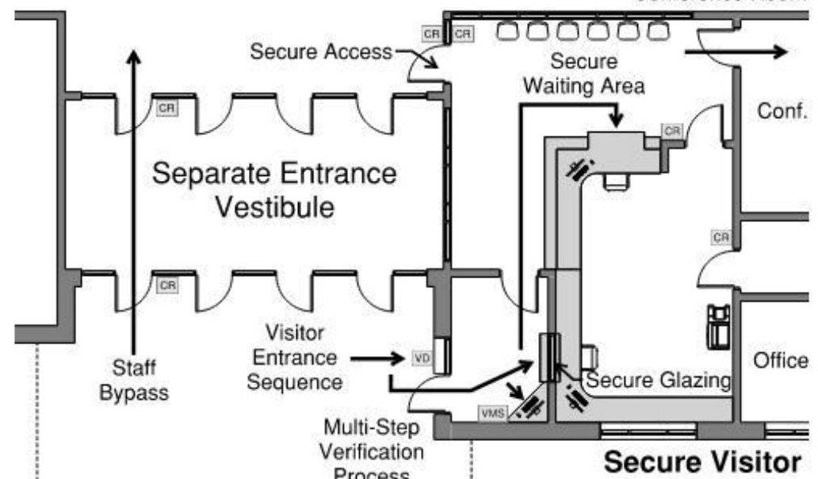
Facilities and Technology
Secure Visitor Entry Center:
Fully-Secure Vestibule
Office Adjacent to Vestibule with Direct Contact
Secure Vestibule Separate from Authorized Users
Secure Waiting Area with Access to Conference Room and Restroom

Slide 14
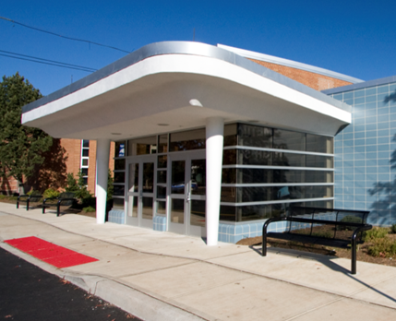
Exterior
Considerations
Balance Security and Welcoming School Environment
Identifiable Main Entrance
Signage
Clear Sight Lines - Observable Approaches
Secured Utilities
Site Lighting

Slide 15
Interior
Considerations
Identifiable Main Office
Drop Off Bins
Interior Window Treatment
Durable Interior Walls
Refuge Areas
Supervision Vantage Points

Slide 16
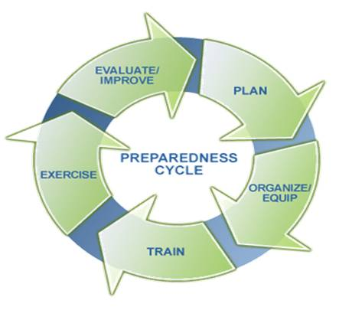
Preparedness
Professional Development
Drills
Provide options (Run Hide Fight, ALICE, etc.)
Evaluate and revise
Reunification Plan- Morris County CCM

Slide 17
Behavioral Health
HIB- Anti-bullying
Identify problems before they happen- security training from the behavioral angle
Threat assessments- policy
Work with local behavioral health centers (outsource & in-house)
Don’t second guess your staff
Require a thorough evaluation prior to returning and district signed form
Follow up- what will be done when the individual returns to school?

Slide 18
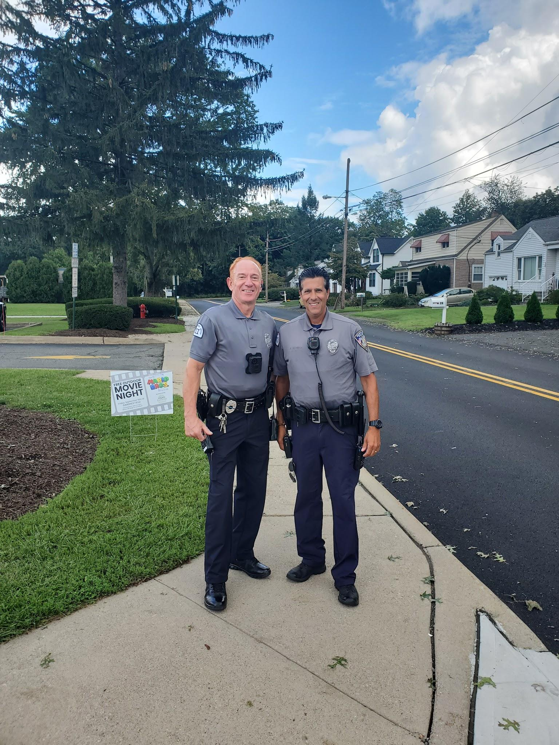
Security Personnel
Security- Armed-Unarmed
Police- Class III
Sole responsibility is security of staff and students.

Slide 19
Activity: write down your answers.
From a January 2023 survey of NJ Superintendents: 262 responses.
What % of NJ districts have...
Armed security personnel?
No security personnel?
Contracted with outside providers for mental health?
Security cameras?
Shatterproof or ballistic glass?
Hired external security experts?
Have installed some type of security vestibule?

Slide 20
NJASA Security Report May 2023
Key Takeaways
January 2023 Survey of NJ Superintendents 262 responses.
57% of the 262 respondents reported having armed security personnel.
Approx 20% have no security personnel.
70% of respondents have contracted with outside providers for mental health.
99.2% have security cameras.
52.3% have shatterproof or ballistic glass employed in some manner.
65% have hired external security experts in some capacity.
77% have installed some form of security vestibules.
The vast majority of Chief School Administrators and Superintendents cited safety and security as their most pressing priority regarding training.
A more comprehensive and exhaustive guide is needed to replace the 2015 school security task force report.
Legislative support for school safety and security infrastructure and personnel upgrades is needed.

Slide 21
Contacts Michael Wozny
michael_wozny@eiassociates.com
Jerry Marinelli
gmarinelli@denville.org
Steve Forte sforte@Denville.org
Reference: School Security Redefined, NJSBA 2018
Questions?

Slide 22
NJASA Report of School Security May 2023
NJASA Report of School Security May 2023- Summary
NJSBA 2018 School Security Redefined

